Slide 1
BIG Paper Project
“Going Places”

Slide 2
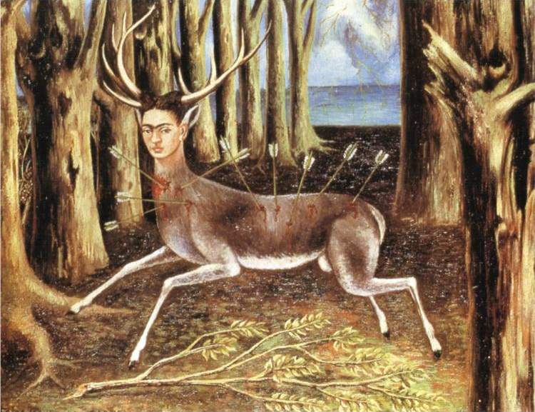
Notes:
Monday WarmUp: Introduction to new artist with see, think & wonder questions

Slide 3
Artist Name: Frida Kahlo
Title of Art Work: “The Wounded Deer”
Medium: Oil
Year: 1946
1. What is your first reaction to this artwork? Why did you react this way?
What’s going on in this artwork?
List 12 adjectives you would use to describe this artwork.

Slide 5
Divergent Thinking Challenge:
Create alternate endings to this comic strip
Notes:
Tuesday WarmUp: Divergent Thinking Challenge (complete the comic strip)

Slide 6
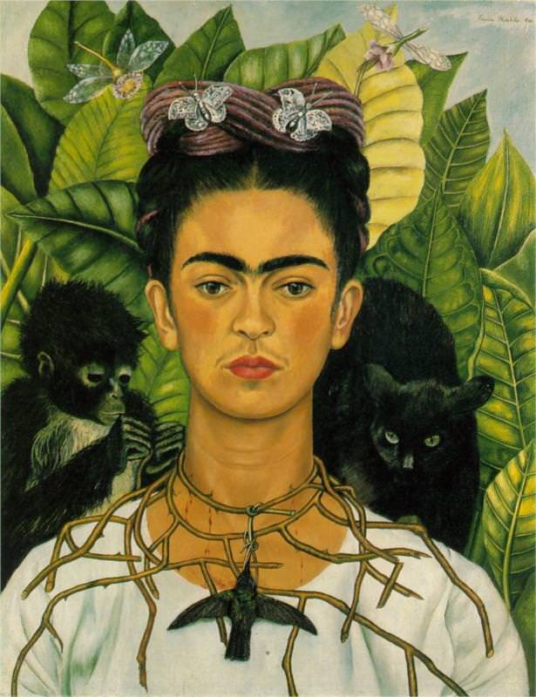
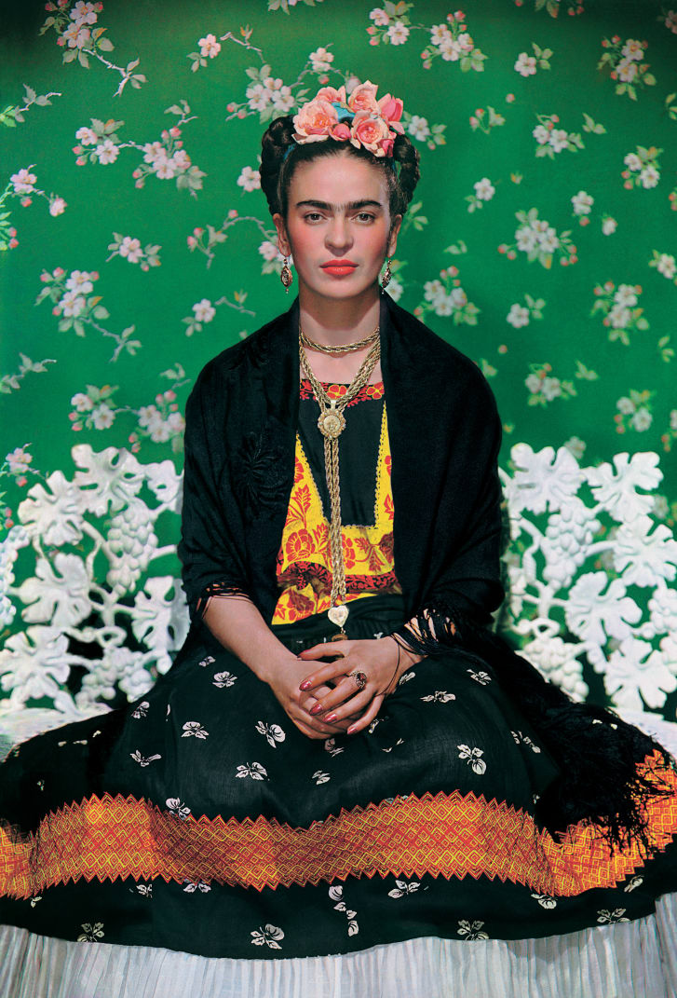
Compare & Contrast:
Notes:
https://www.fridakahlo.org/self-portrait-with-necklace-of-thorns.jsp https://www.cnn.com/style/article/frida-kahlo-mexican-fashion/index.html
Wednesday WarmUp: Compare and Contrast

Slide 7
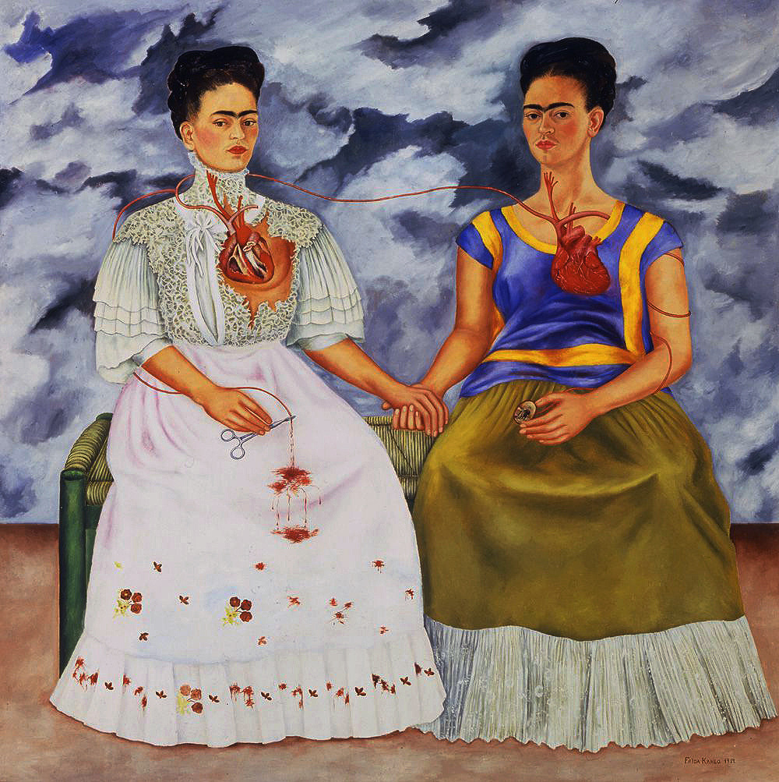
Notes:
Thursday WarmUp: Free doodle/Free sketch

Slide 8
Mindfulness Meditation
Notes:
Friday WarmUp: Social Emotional Learning through the practice of Mindfulness. I use the “Breathe” app.

Slide 12
National Visual Arts Standard 2
Organize and develop artistic ideas and work.

Slide 13
Enduring Understanding
Artists and designers experiment with forms, structures, materials, concepts, media and art-making approaches.

Slide 14
What are we doing?
Group project done with art making tools we have used in class this rotation on a BIG paper connecting to the theme of “Going Places”.

Slide 15
Why are we doing this?
To bring our ideas together in a mashup with others and what creations/ideas ensue.

Slide 16
When are we doing this?
Thursday September 19 – Tuesday September 21

Slide 17
Who are we doing this for?
We are doing this to add positive value and vibes while inspiring the imaginations of those that walk the halls of SMS.

Slide 18
Austin’s Butterfly

Slide 19
Class Motto:
I am blessed with the gift of making mistakes. Everyday. Everyday. Everyday!

Slide 20
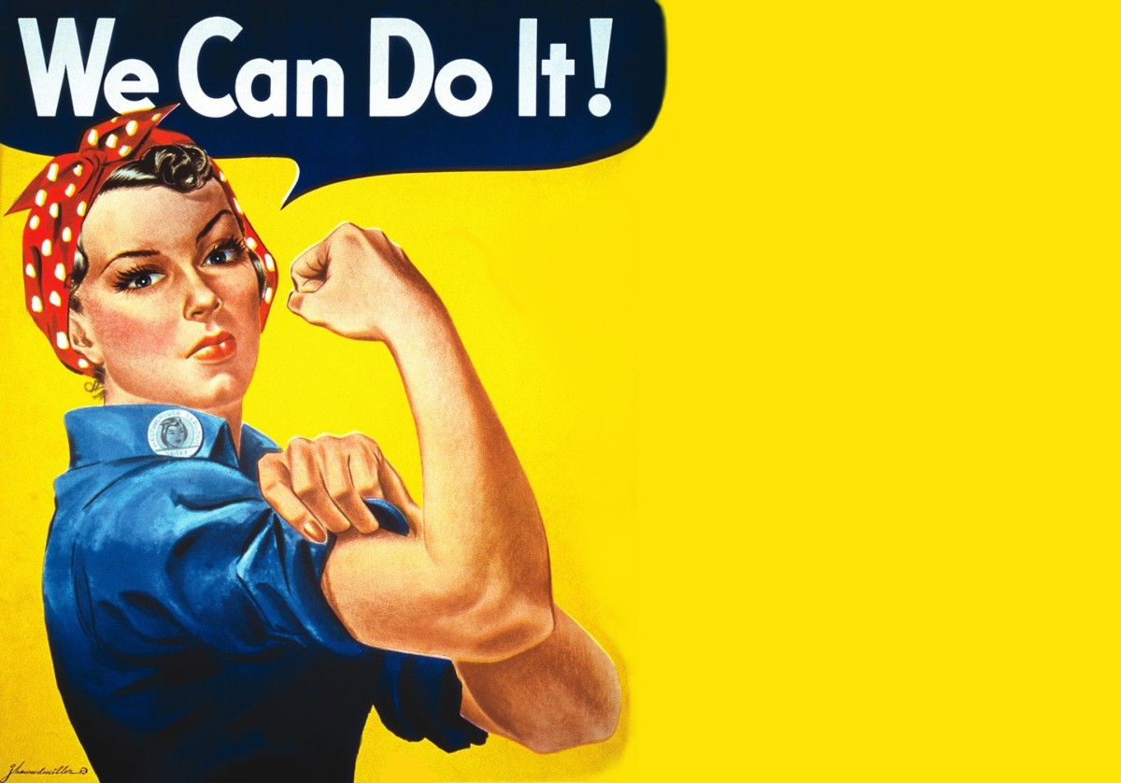

Slide 21
I can learn to look more closely & see things that may otherwise not be seen.
Notes:
Project “I can…” statement

Slide 22
Element of Art: Space
Notes:
This week’s project Element of Art focus.

Slide 23
Vocabulary:
Space
Scale
Proportion
Inclusive

Slide 24
Tools & Materials:
Imagination
Pencil
Sketch Paper
Crayons
Colored Pencils
Markers
Watercolor Paints
BIG Paper

Slide 25
“BIG Paper”
The Breakdown:
Use sketch/scratch paper to make your own sketch connecting to the theme “Going Places”
Join a group
Mashup all group members ideas to create new sketch for the group
Teacher check
Begin working on BIG Paper
Group Reflection: Present to class and answer questions
Display in art studio hallway

Slide 26
Studio Time ☺
Notes:
https://www.youtube.com/watch?v=hHW1oY26kxQ

Slide 27
Clean Up

Slide 28
Reflection: Please use complete sentences to answer the following…
Am I learning an interesting skill or information on this project?
Why is my art important?
How did I move through mistakes, struggles or bumps in the road on this project/today?

